Slide 1
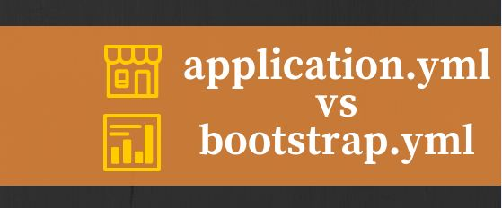

Slide 2
Difference Between Application.Property & Application.Yml
on
Technology4NextVision
2019

Slide 3
Application Yaml File:
Spring Boot supports YAML based properties configurations to run the application. Instead of application.properties we can use application.yml file. This YAML file also should be kept inside the classpath(file location src/main/resources). The sample application.yml
file is given below
datasource:
driverClassName: oracle.jdbc.driver.OracleDriver
url: jdbc:oracle:thin:@manoj:1521:orcl
username: tog
password: sci
In the Spring Boot application, the configuration files are either application.properties or application.yml . The application.yml config file will contain application-related configurations, such as server port, JPA configuration, and data source configuration.

Slide 4
Advantage of YAML
In YAML, there is no extra delimiter is used. So it is the lightweight than XML and JSON.
YAML makes the data understanding easy. So it is useful in case of configuration.
When used YAML then no need to require to do extra configuration in other files
YAML file follows KEY and VALUE pair means follow MAP structure means KEY can’t duplicate
Using YAML file we remove boiler code
Note –For more detail you can go through this video.

Slide 5
Disadvantage of YAML
Scaling problem
Note –For more detail you can go through this video.

Slide 6
BOOTSTRAP.YAML
A Spring Cloud application operates by creating a “bootstrap” context, which is a parent context for the main application.
Out of box we can tell It loads outside configuration file in our local application
Example-Eureka server is running on another port i.e. eureka is a different service and running on different port so we use Bootstrap.yml in our project to create communication between our service and eureka.

Slide 7
Advantage of BOOTSTRAP
Bootstrap.yml (bootstrap.properties) get loaded before application.yml file
Application context in Spring Boot first loads Bootstrap.yml file then it loads either of application.properties or application.yml.
For example we are doing configuration in Bootstrap.yml for two properties
spring.application.name and spring.cloud.config.server.git.uri like below
spring:
application:
name: demo
cloud:
config:
uri: ${CONFIG_SERVER_URL:http://localhost:8888}
Eureka config below.(I will explain in other vedio and other document)
spring:
application:
name: eureka
cloud:
config:
uri: ${CONFIG_SERVER_URL:http://localhost:8888}

Slide 8


